Slide 1
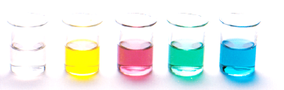
Empirical formula
Essential Chemistry chapter 13
Empirical and molecular formula
Using empirical data to determine a compound’s empirical formula

Slide 2
Empirical formula
Some compounds, such as organic compounds, have a molecular structure
Each molecule is a cluster of two or more atoms strongly bonded together by covalent bonds
A molecular formula shows an actual number of each type of atoms in a single molecule of the substance
An empirical formula only shows the types of atoms present in a substance and gives the simplest whole number atomic ratio

Slide 3
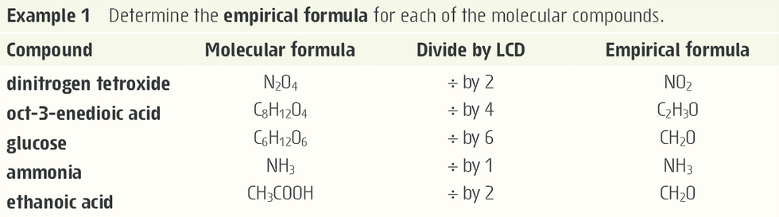
Empirical formula
Empirical formula can be found from the molecular formula by dividing the subscripts by the lowest common denominator (LCD)

Slide 4
Empirical formula
Chemical composition of a compound, i.e. its composition by mass or its % composition by mass can be found experimentally
The empirical data can be used to find the compound’s empirical formula

Slide 5
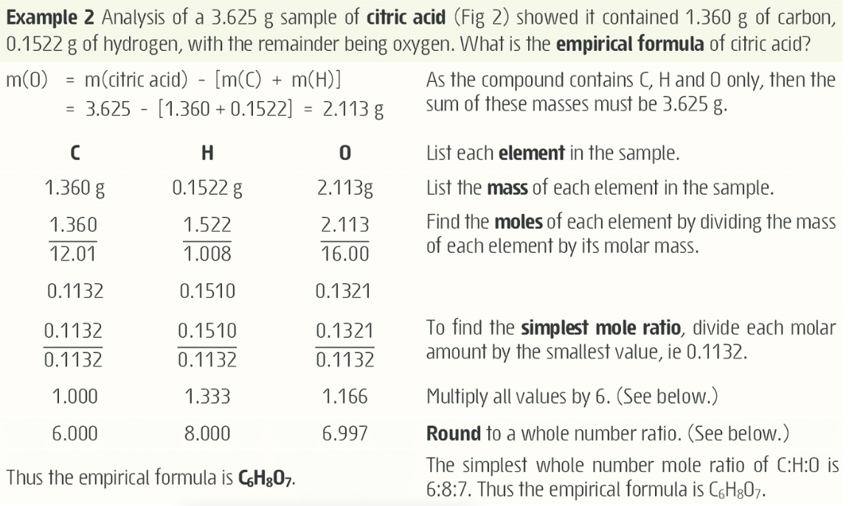

Slide 6
Empirical formula
If dividing by the smallest molar value doesn’t produce doe not produce a whole number ratio – try multiplying the result by 2, 3, 4, 5 and so on. This involves trial by error until a whole number ratio is achieved for all elements.
Rounding – when rounding your empirical formula it should be very close to whole numbers (depending on the accuracy and precision of the data). You can round empirical ratios that are within ±0.05 of being a whole number
Carry at least 4 significant figures throughout your calculations for an empirical formula

Slide 7
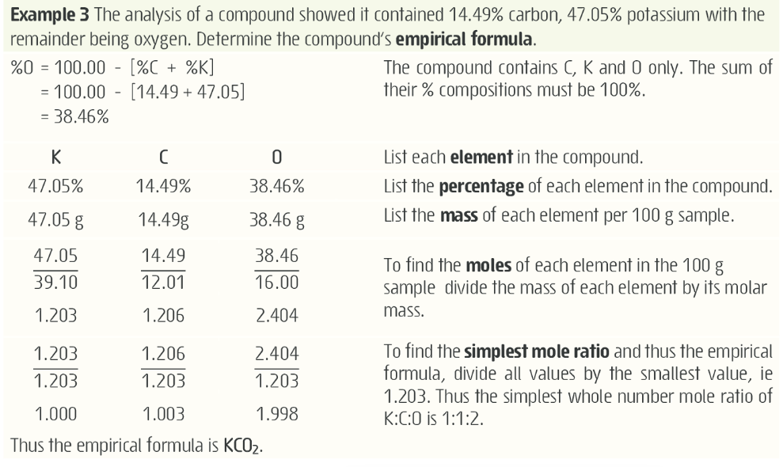

Slide 8
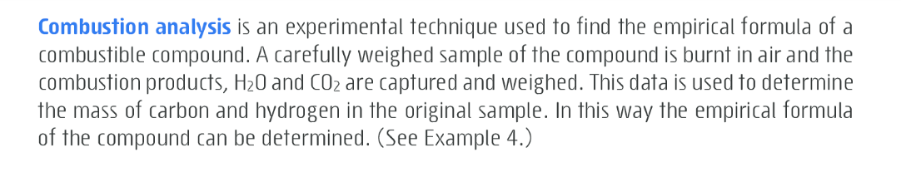
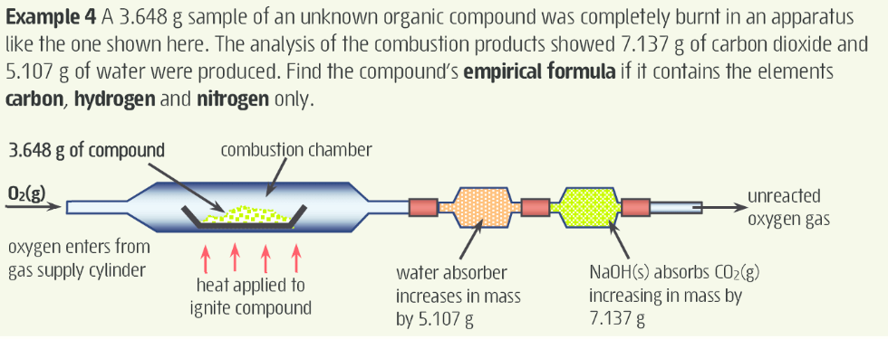
Combustion analysis

Slide 9
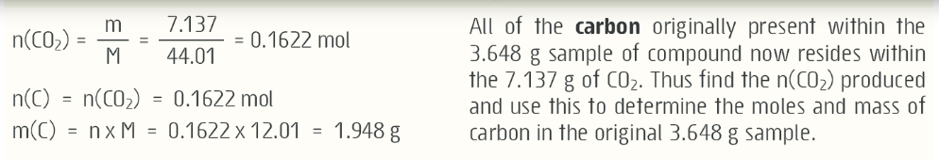
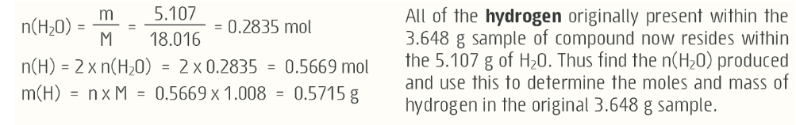
Combustion analysis

Slide 10
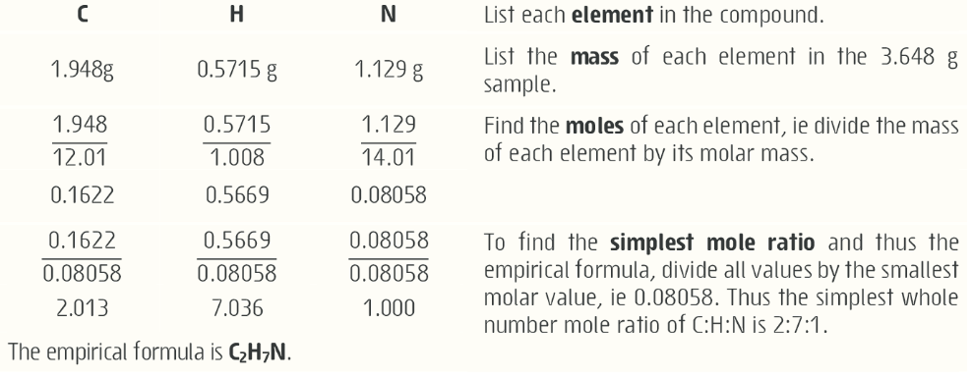
Combustion analysis

Slide 11
Finding the molecular formula
Remember: Molecular formula shows the actual number of each type of atom in one molecule of the compound
It is always a whole number multiple of the empirical formula
Molecular formula can be found by comparing the empirical formula mass, M_{ef} to the molecular formula mass, M
By finding the ratio of M/M_{ef}

Slide 12
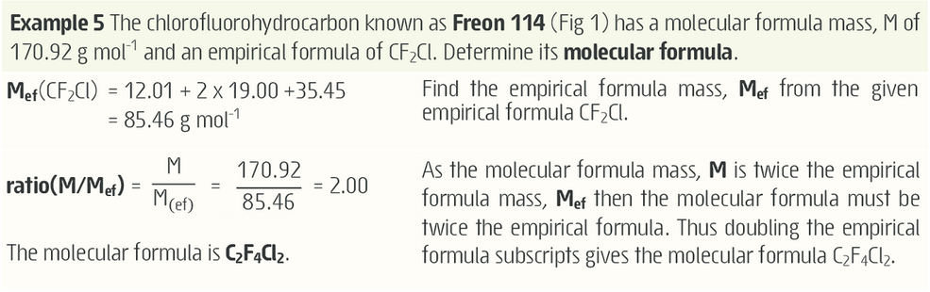
Finding the molecular formula

Slide 13
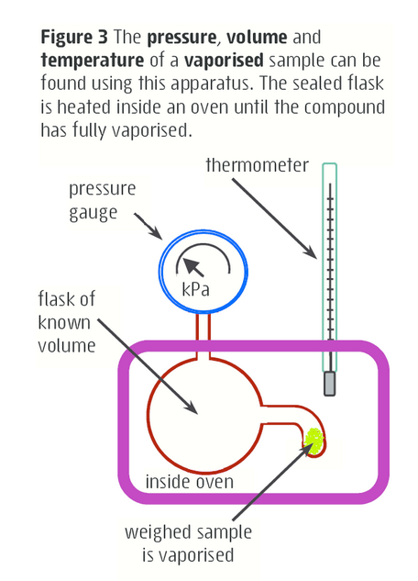
Finding the molecular formula
How do we find out the molecular formula mass of a compounds?
One method involves vaporising a weighed sample in a sealed flask of known volume. The temperature and pressure of the resulting gas is measured and used along with the volume and mass to experimentally determine the molar mass

Slide 14

Finding the molecular formula
Ideal gas law – recall. P = pressure (kPa), V = volume (L), n = moles (mol), T = temperature (K) and R = gas constant = 8.314 J/mol

Slide 15
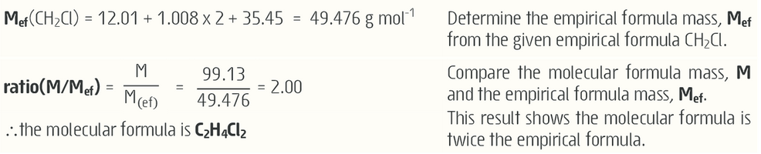
Finding the molecular formula

